Slide 2

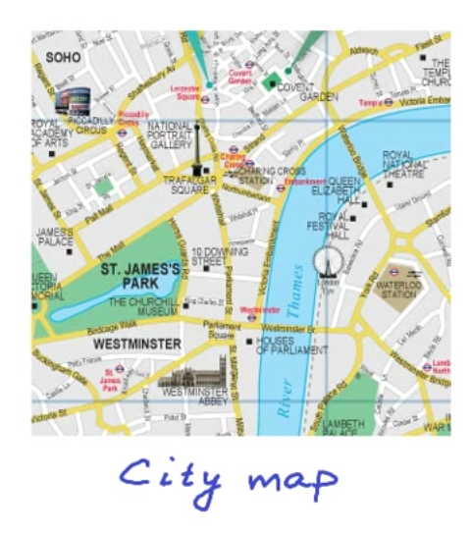
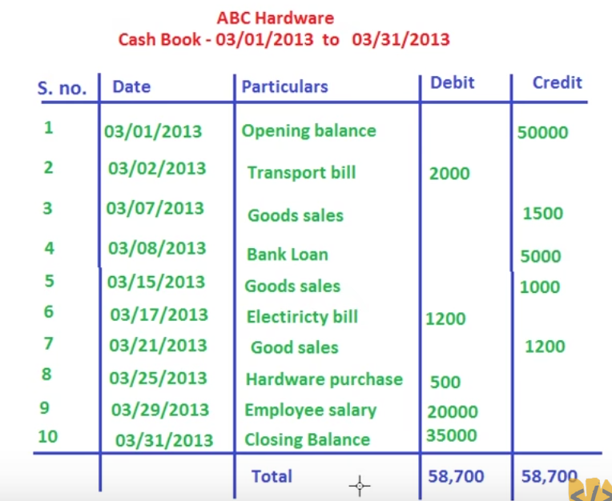
Data structure is the most fundamental and building block concept in computer science and good knowledge of data structures is a must to design and develop efficient software systems.
we deal with data all the time and how we store, organize and group our data together matters.
Let's pick up some examples from our day to day life where organizing data in a particular structure helps us.
We are able to search a word quickly and efficiently in a language
because the words in the dictionary are sorted
What if the words in the dictionary were not sorted?
It would be impractical and impossible to search for a word among millions of words.
So, dictionary is organized as a sorted list of words.
so different kind of structures are needed to organize different kind of data
the data, like position of the landmark road network connections, all this data is organized in the form of geometries.
We show the map data in the form of these geometries on a two-dimensional plane.
So, map data needs to be structured
so that we have scales and directions and we are effectively able to search for a landmark and get route from one place to another
daily business (cash in & out) statement:
it makes most sense to organize and store the data in the form of a tabular schema
it is very easy to aggregate data and extract information, if the data is organized in these columns, in these tables

Slide 3
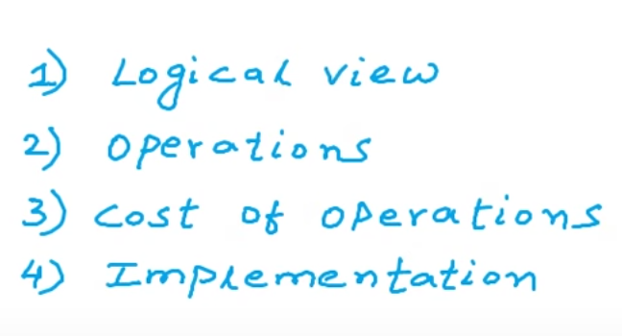
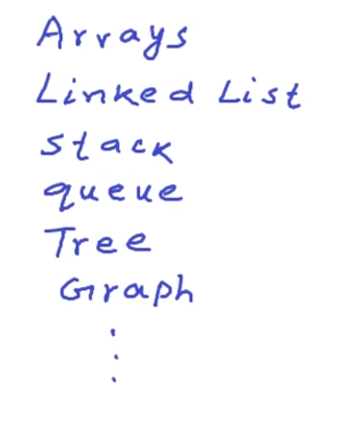
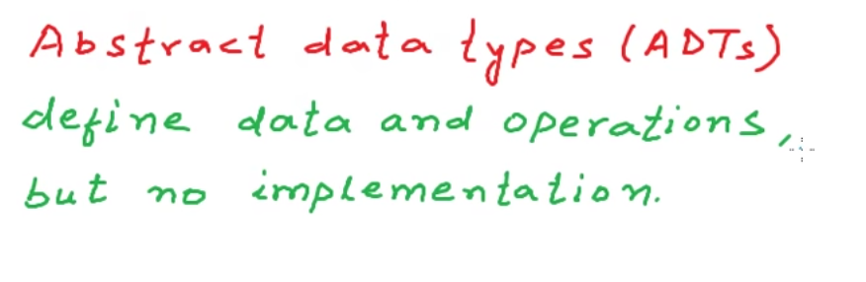
Computers work with all kind of data,
computers work with texts, images, videos, relational data geospatial data and pretty much any kind of data
how we store organize and group data in computers matters a lot,
because computers deal with really really large data
if we do not use the right kind of structures, the right kind of logical structures, then our software systems will not be efficient
Formal `definition` of data structure:
Data Structure is a way to store and organize data in a computer
so that the data can be used efficiently
(Time Complexity)

Slide 4
List

Slide 5
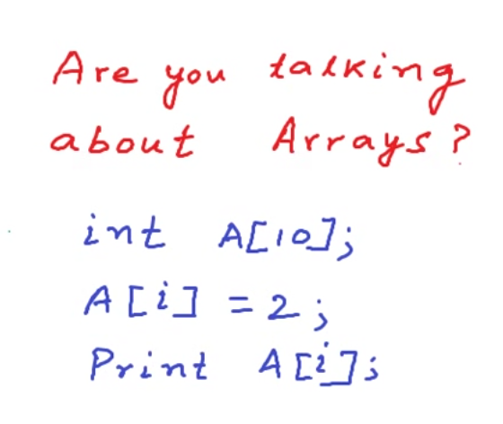
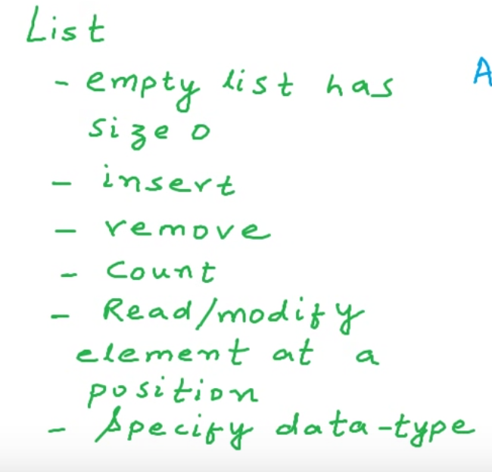
No, needs to be dynamically expanded
So, we need to add additional behaviors to Array
--to support dynamic expanding

Slide 6
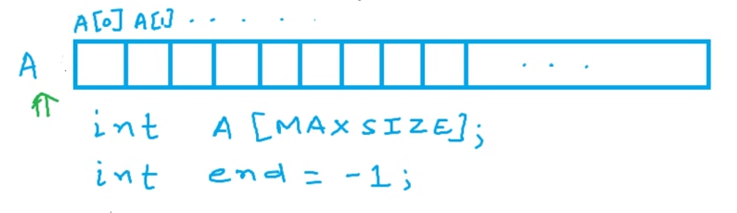
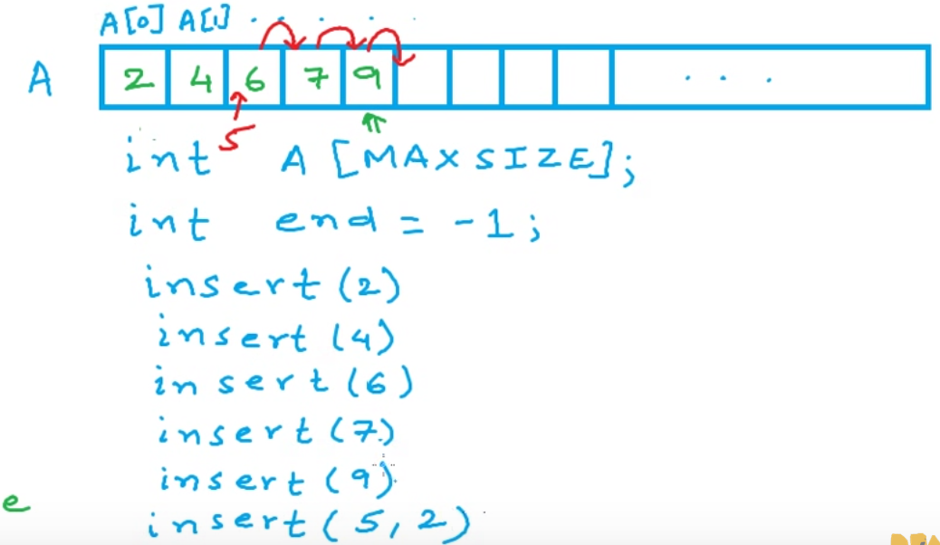
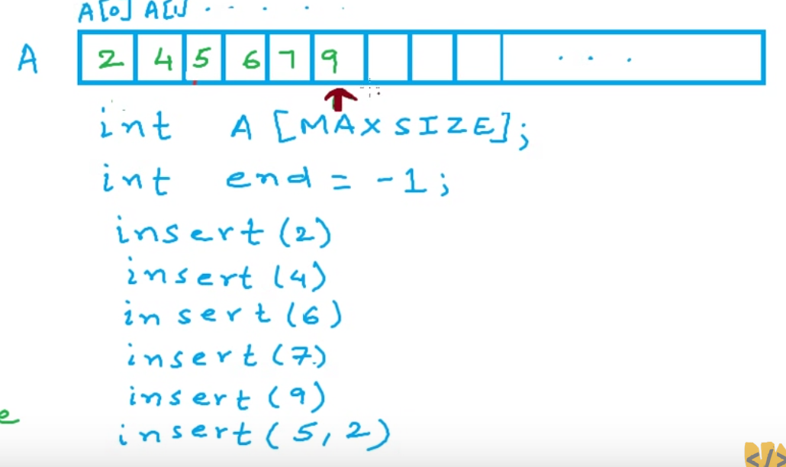
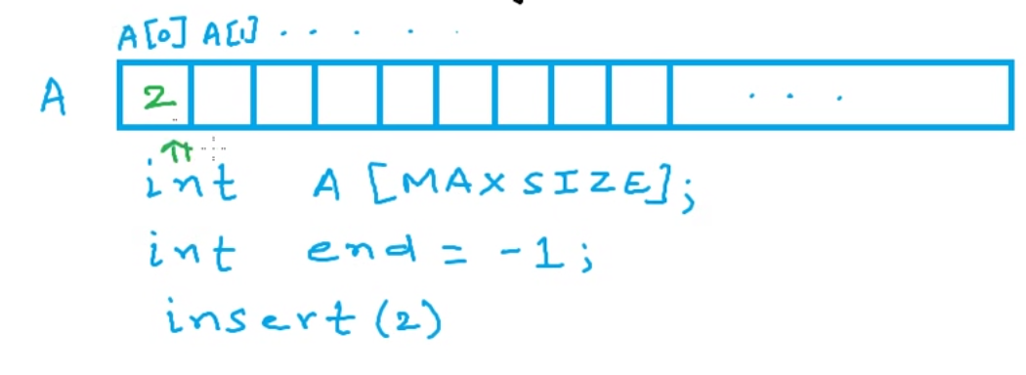
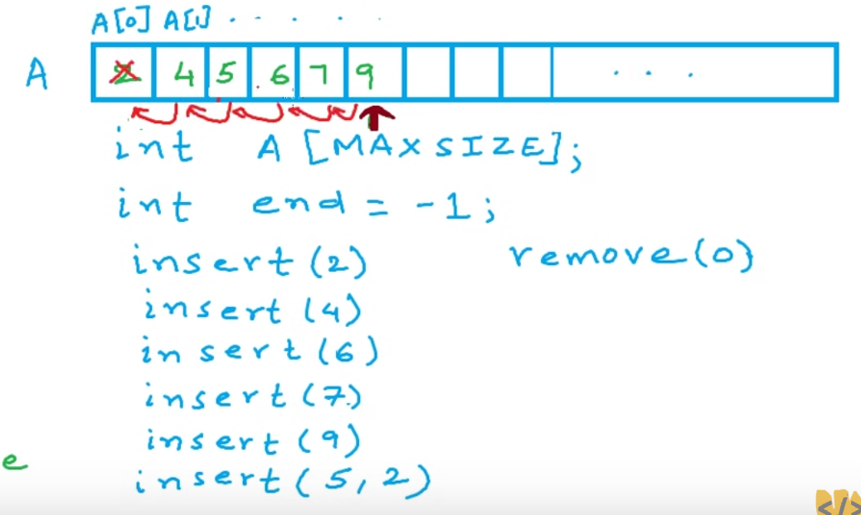
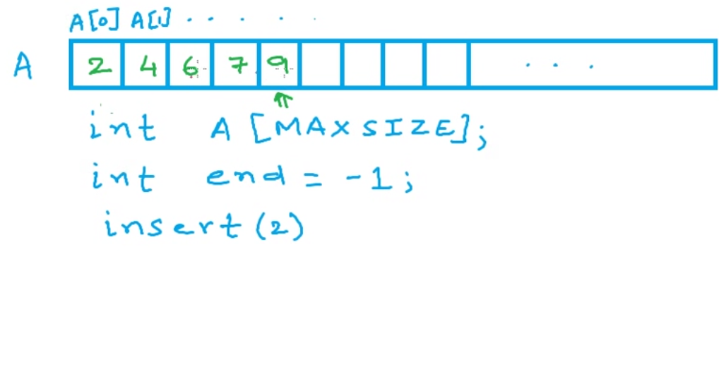
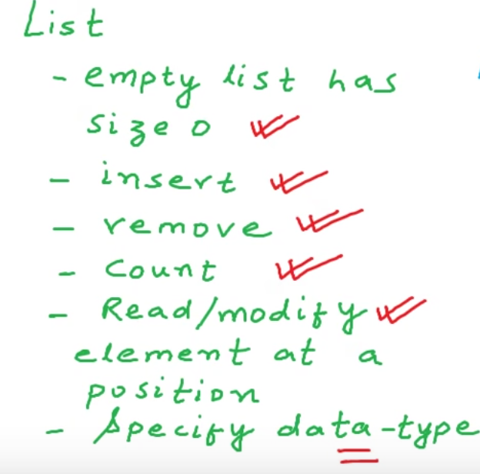
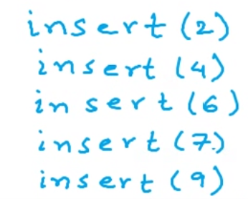
[-1]
end
is ( -1 )
end is 0
end is 4

Slide 7
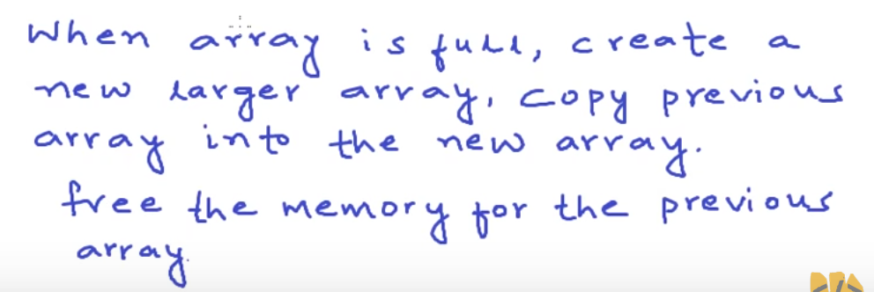
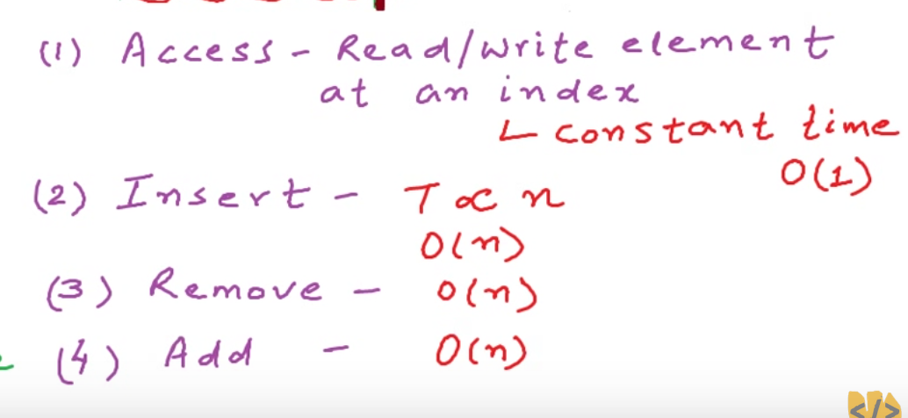
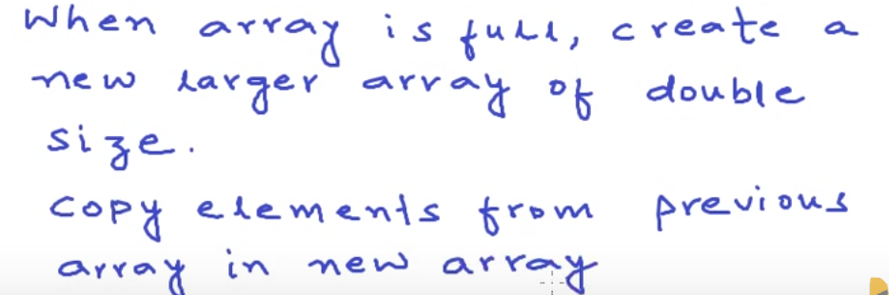
Good
(Consider insert in middle too)
(Consider remove in middle too)
(Adding More than array size)
(creating new array)
and
(copying old items to new array)
operations
(5) Un used Memory
Bad

Slide 8
Linked List

Slide 9
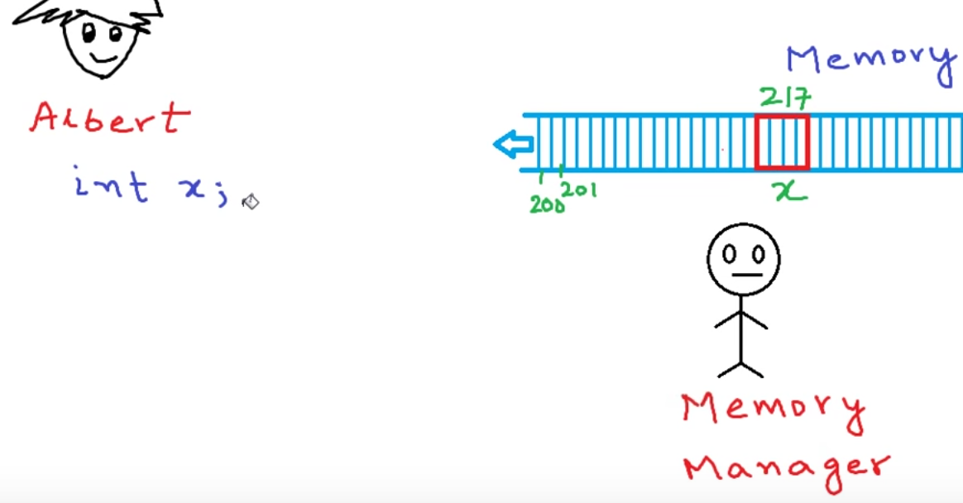
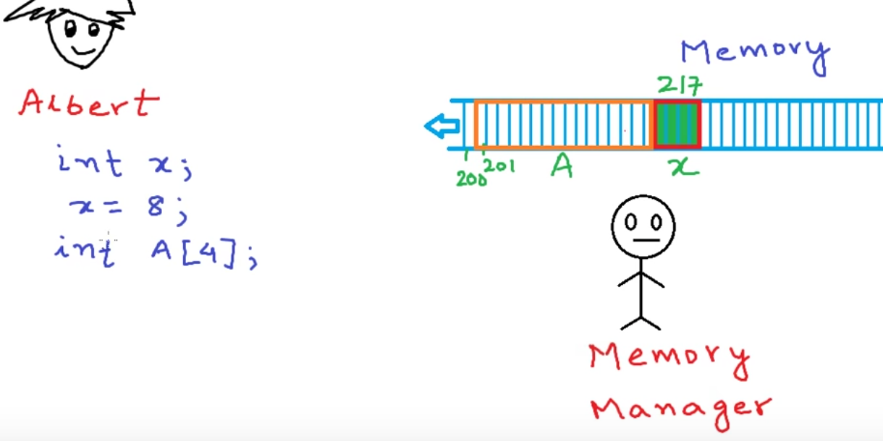
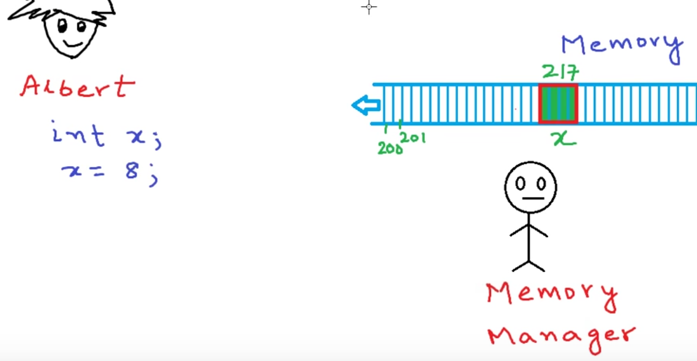
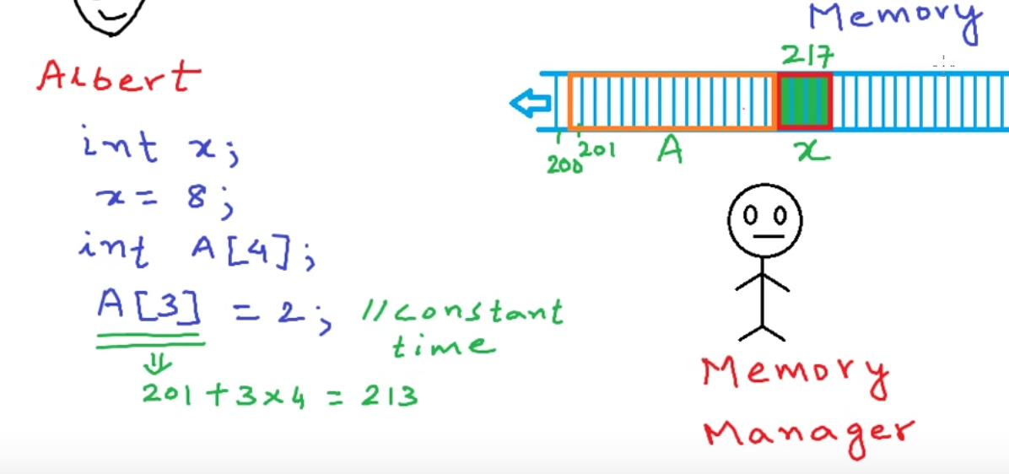
(Developer)
// 200
8
2

Slide 10
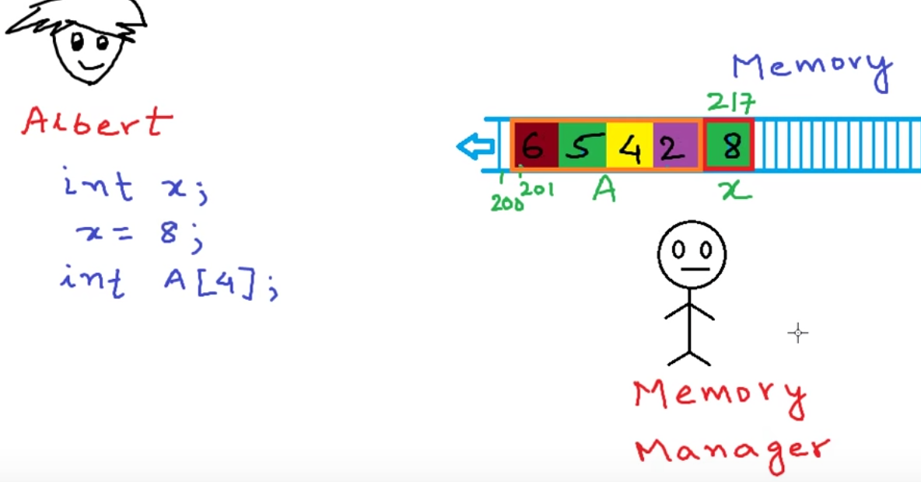
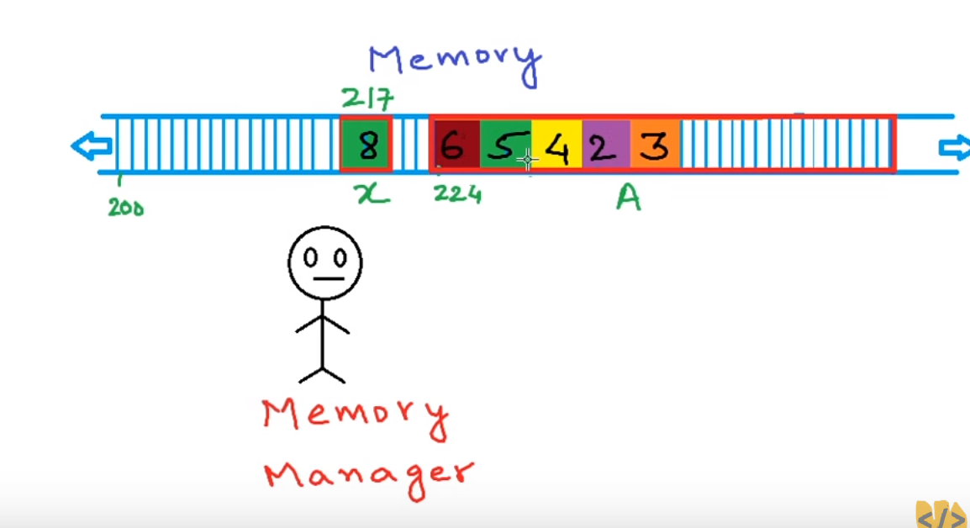
Add 5th element
Memory Manager will not allow you to extend the same array
Because Arrays occupies contiguous memory allocation
occupies memory continuously
Memory Mgr cannot extend the array simply
Because Memory Mgr might already assigned some other variable memory in the next address (may or may not be)
So, It is better to create a new array with double the size and copy the old array values and freeup old array
A[0] = 6;
A[1] = 5;
A[2] = 4;
A[3] = 2;
Add 5th element

Slide 11
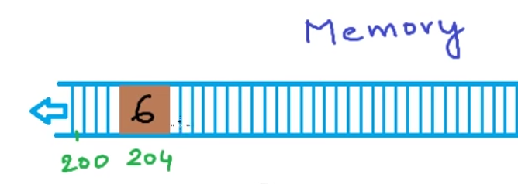
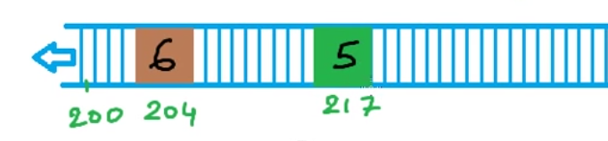
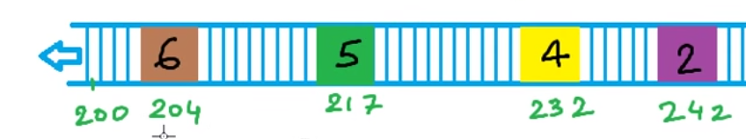
Memory is wasted
But still ‘Albert’ is not happy with the solution
Because
If the list very small, memory is wasted
If the list more than currently increased size,
Again we have to create new array & copy all previous values to new array
‘Albert’ is desperately seeking a solution to this problem
Solution to this problem is ‘Linked List’
instead of asking for one large contiguous block of memory
He can ask memory for one element at a time in a separate request

Slide 12
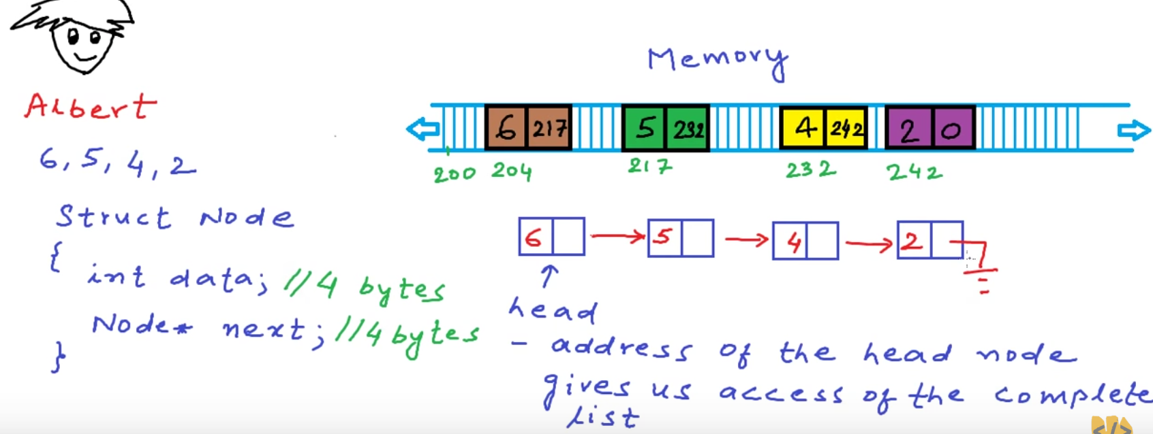
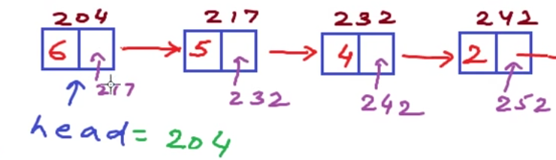
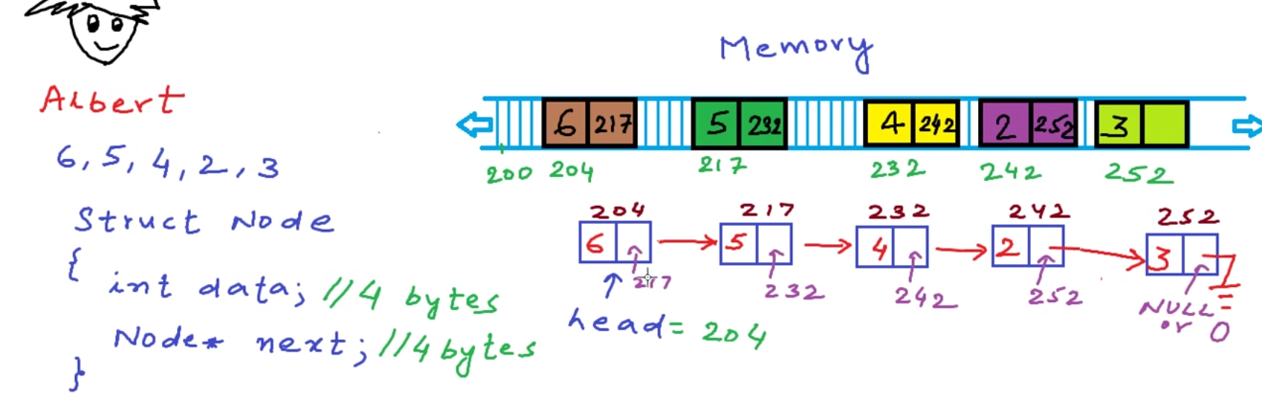
to store the information that this is the first block in the list and this is the second block in the list
to link these blocks together,
what we can do is that
we can store some extra information in each block
each block will store the data and the address of the next block
Add 5th element
(Very easily)

Slide 13
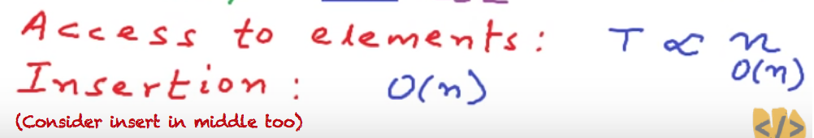
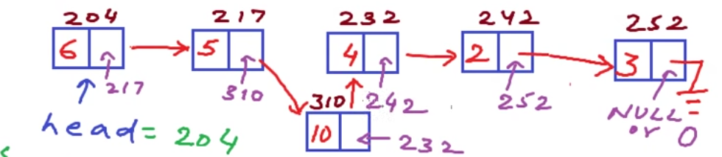
unlike arrays we cannot access any of the elements in constant time in the case of arrays using the
starting address of the block of memory and using the position of the element in the list, we could calculate the address of the element
but in this case we have to start at the head and we have to ask this element for the next element and then ask the next element who is your next,
it's like playing treasure hunt.
You go to the first guy and then you get the address for the second and then you go to the second guy and you get address of the third guy.
so the time taken to access elements will be proportional to the size of the list
that is no extra use of memory in the sense that some memory is unused
We are using some extra memory, we are using some extra money to store the addresses
but we have the benefit that we create nodes as and when we want and we can also free the nodes as
and when we want we do not have to guess the size of the list beforehand like in the case of arrays

Slide 14
So which one is better - an array or a linked list ?
Well, there is no such thing as one data structure is better than another data structure.
One data structure may be really good for one kind of requirement,
while another data structure really good for another kind of requirement.
So, it all depends upon factor like
what is the “most frequent operation” ---that you want to perform with the data structure
or what is the “size of the data”
or it might have other factors too

Slide 15
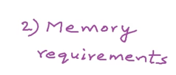
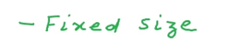
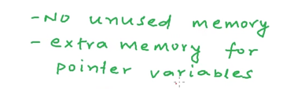
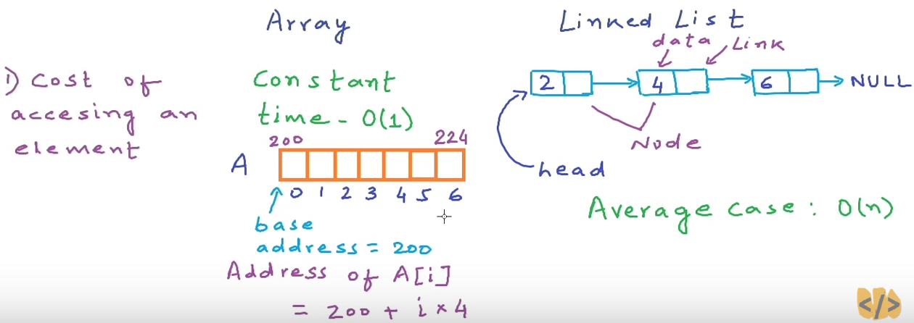
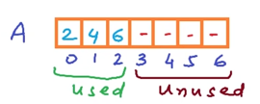
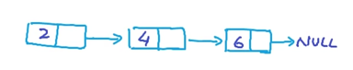
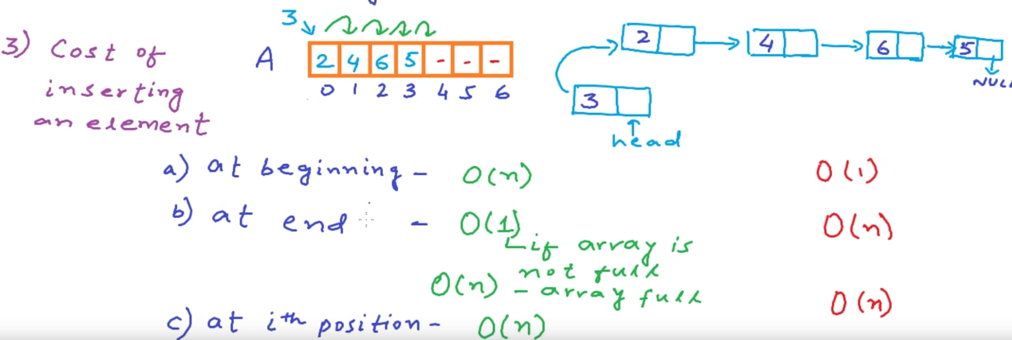
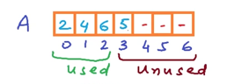
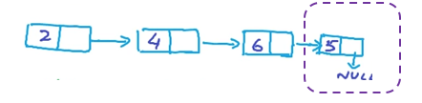
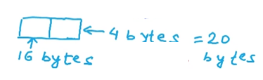
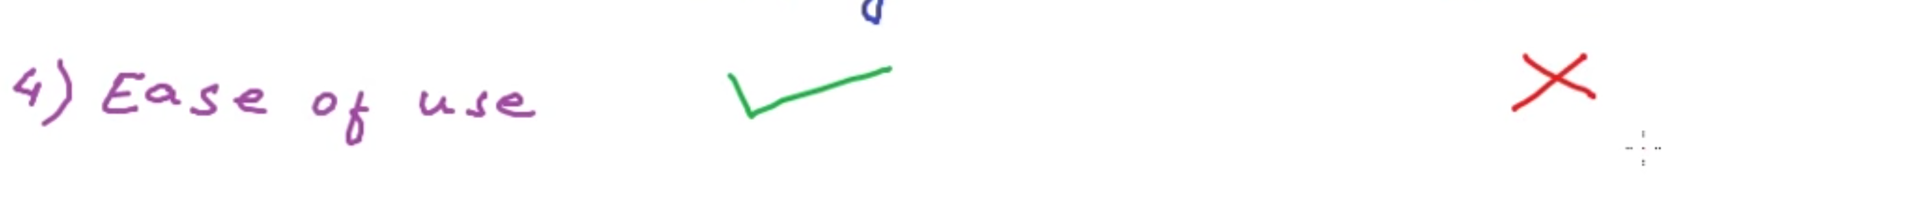
3 elements
8 x 3 = 24 bytes
4 x 7 = 28 bytes
4byte + 4 byte = 8 byte
4byte —for integer (data)
4byte –for nextNode (address is integer)
‘removing’
also same
4 elements
4 x 7 = 28 bytes
8 x 4 = 32 bytes
If we have some ‘complex - data type’, e.g. 16 byte data
4 elements
16 x 7 = 112 bytes
20 x 4 = 80 bytes
sometimes when we may want to create a really really large array,
memory may not be available as one large block
memory may be available as multiple small blocks

Slide 16
Stack

Slide 17
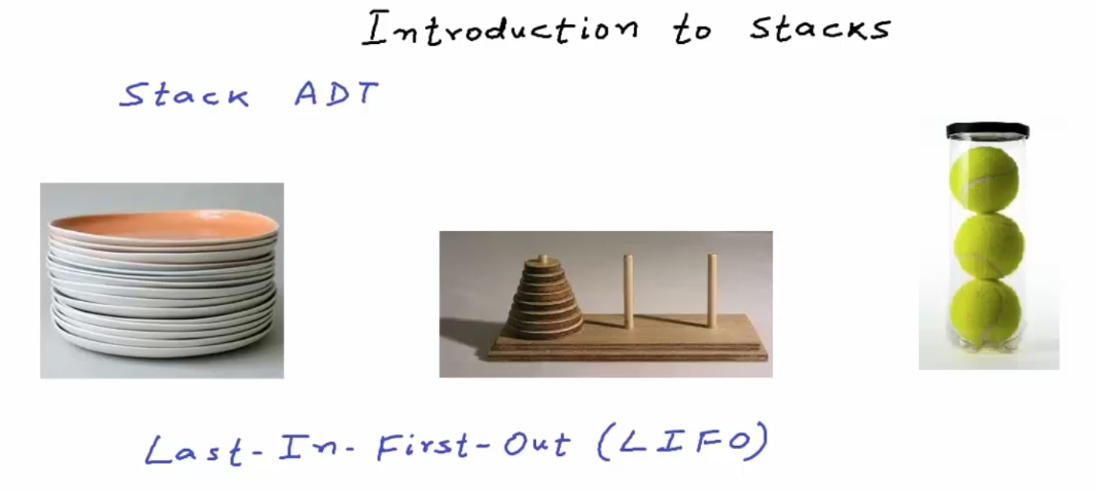

Slide 18
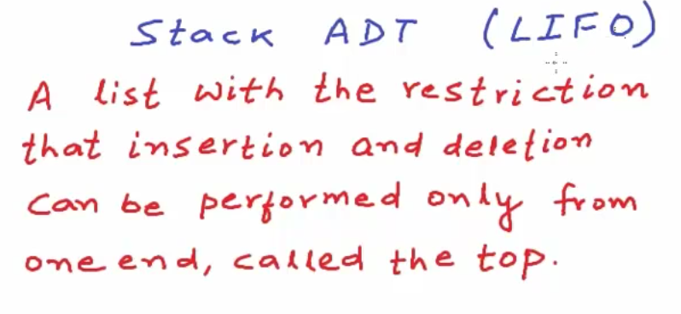
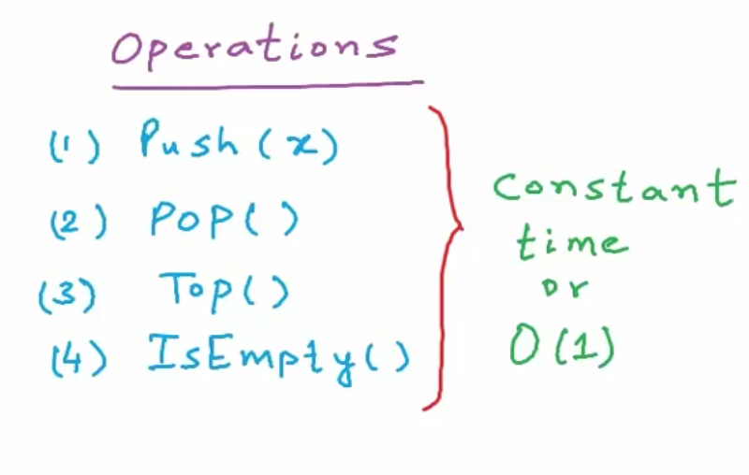

add()
remove()
getFirstItem()
(but don’t remove it)
add()
remove()
add() and remove()
happens at the same place
That place is called ‘top’
We cannot directly add or remove
an item in middle

Slide 19
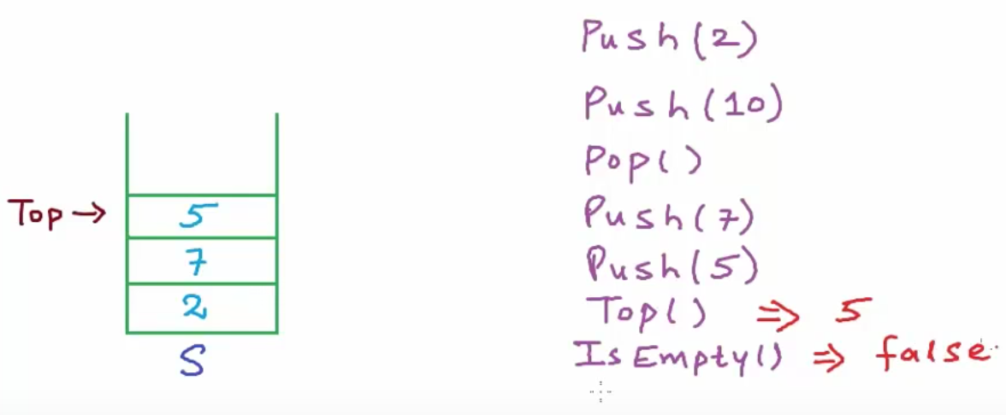
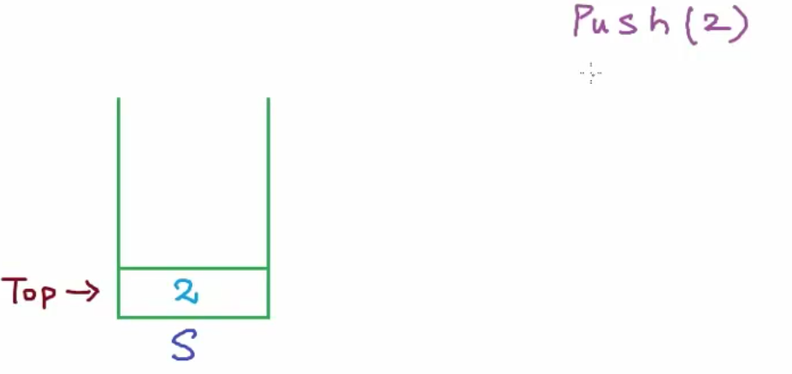
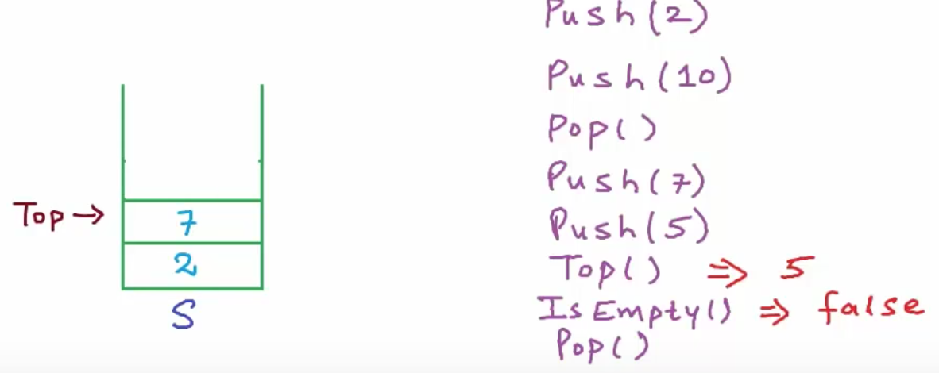
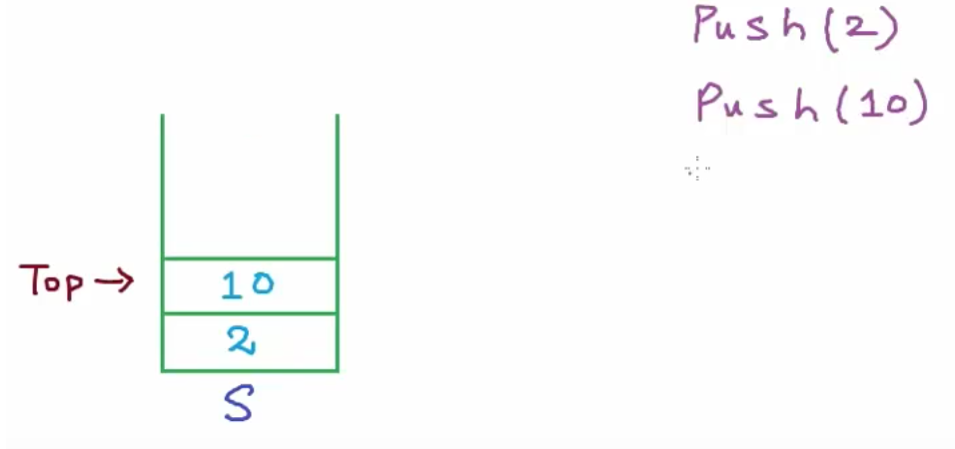





Real-time Use Case

Slide 20
Queue

Slide 21






remove()
remove() happens at ‘front’ or ‘head’
add()
add() happens at ‘rear’ or ‘tail’

Slide 22







Real-time Use Case

Slide 23

add()
remove()
add() and remove()
happens at the same place
That place is called ‘top’
Stack
We cannot directly add or remove
an item in middle
remove()
Queue
remove() happens at ‘front’ or ‘head’
add()
add() happens at ‘rear’ or ‘tail’

Slide 24
Tree

Slide 25


In these structures ,
we have a logical start and a logical end
and these collections can have a next element and previous element.
It is a linear or sequential arrangement.

Slide 26


Root at top
&branching out in downward direction.
Tree is one data structure that's quite often used to represent hierarchical data.
but this is not the only application of tree in computer science.
Tree data structure can be defined as a collection of entities called nodes linked together to simulate hierarchy.
Tree is a non-linear data structure. Its a hierarchical structure.
The topmost node in the tree is called root of the tree.
Each node will contain some data and this can be data of any type.
So, we can have an object with two string fields
one to store name and another to store designation.
each node will contain some data
and may contain link or reference to some other nodes
that can be called its children.

Slide 27










links are not bidirectional
Tree is Uni-Directional
Lets pick up this node numbered 10.
(1, 2, 5) are all ancestors of 10
and 10 is a descendant of (1, 2, 5) nodes.
We can walk from any of these (1, 2, 5) nodes to 10.
What are the common ancestors of 4 and 9?
ancestors of 4 are 1 and 2
ancestors of 9 are 1,2 and 5.
So, common ancestors will be 1 and 2.
Are 6 and 7 sibling?
Sibling must have same parent.
6 and 7 do not have same parent.
Then, No it is not sibling
But, They have same grand-parent (1)
Nodes not having same parent
but having same grandparent can be called 'cousins'
So, 6 and 7 are cousins.

Slide 28




We can also say that node number 3 is uncle of node number 6
because its sibling of 2
tree with n nodes, there will be exactly n-1 links or edges.
Each arrow in this figure can be called a link or an edge.
All nodes except the root node will have exactly 1 incoming edge.
If you can see, I'll pick this node numbered 2.
There is only one incoming link and one or many outgoing links.
There will be one link for each parent-child relationship.
So, in a valid tree if there are n nodes, there will be exactly n-1 edges.
One incoming edge for each node except the root.
We can further split the left sub-tree and look at it like node number 2 is root of this sub-tree
and this particular tree with node number 2 as root has 3 sub-trees.
Recursion basically is reducing something in a self similar manner.
This recursive property of tree will be used everywhere
in all implementation and usage of tree.

Slide 29






For this node numbered 5,
we have 2 edges in the path from root.
So, the depth of this node is 2.
In this tree here, depth of nodes 2 and 3 is 1.
height of a node in tree can be defined as
number of edges in longest path from that node to a leaf node.
for node 3,
the longest path from this node to any leaf is 2.
So, height of node 3 is 2.

Slide 30
Binary Tree

Slide 31

(Name Suggestion, Auto Complete, Spell Check)

Slide 32





BT is like a ‘Linked List’
This particular definition of Node can be used only for a binary tree.
because we can have at most 2 children in binary tree.
For generic trees that can have any number of children,
we use some other structure

Slide 33















Possible Binary Trees
What will be height of a perfect binary tree with N nodes.
To find out height, we'll have to solve this equation n = 2^h+1 - 1
These all are binary tree.
Remember, the only condition is that a node cannot have more than 2 children.

Slide 34







when we will have a sparse tree like this, which is as good as a linked list.
time taken for an operation is proportional to height of the tree
or in other words
if time complexity of an operation is big-oh of h where h is height of the binary tree,
then for a complete or perfect binary tree,
time complexity will be big-oh of log n to the base 2
and in worst case , time complexity will be big-oh of n.
For example, in Binary Search Tree which is a special kind of Binary Tree,
the cost of searching, inserting or removing an element
in terms of Time is proportional to the Height of Tree.
So, in such case we would want the height of the tree to be less.
Height of a tree will be less if the tree will be dense,
If the tree will be close to a Perfect Binary Tree or a Complete Binary Tree.
if we will have an arrangement like this,
then the tree will have maximum height.
So, here is the thing. Quite often,
we want to keep the height of a binary tree minimum possible
or most commonly, we say that
we try to keep a binary tree balanced.
With n nodes,
minimum height possible is floor of or integral part of log n to the base 2
maximum height possible with n nodes in n-1
( Order of log n is almost best running time possible )
For n as high as 2¹⁰⁰,
log n to the base 2 is just 100.
If n is 2¹⁰⁰ elements,
With order of n running time,
if n will be 2¹⁰⁰
we won't be able to finish our computation in years
even with most powerful machines ever made.
log₂ ₍ 2¹⁰⁰ ₎ → 100

Slide 35


Quite often, people calculate height as
‘number of nodes' in longest path from root to a leaf.
We call a binary tree, Balanced Binary Tree,
if for each node,
the difference between height of left and right sub-tree is not more than some number k.
Mostly k would be 1.
So, we can say that for each node,
difference between height of left and right sub-tree should not be more than 1.
We had defined height earlier as ‘number of edges’ in longest path from root to a leaf.
Height of a tree with just one node where the node itself will be a leaf node will be
We can define an empty tree as a tree with no node
and we can say that height of an empty tree is -1.
So, height of tree with just one node is 0 and height of an empty tree is -1.
In this figure, I have drawn one of the longest paths from root to a leaf.
We have 3 edges in this path.
So, the height is 3.
If we will count number of nodes in the path, height will be 4.
This looks very intuitive and I have seen this definition of height at lot of places.
if we will count the nodes, height of tree with just one node will be equal to 1
and then we can say that height of an empty tree will be 0,
but this is not the correct definition and we are not going to use this assumption.
We are going to say that
height of an empty tree is -1
and height of tree with one node is 0.

Slide 36




Sometimes height of a sub-tree can be -1 also.
For this leaf node here in this figure,
both left and right sub-trees are empty,
so both hleft and hright will be -1,
but the difference overall will be 0.
For all nodes in a perfect tree, difference will be 0.

Slide 37


I have written the value of diff.
This is still a balanced binary tree
because the maximum diff for any node is 1.
now this is not balanced
because one of the nodes has diff 2.
For this particular node,
height of left sub-tree is 1
and height of right sub-tree is -1
because right sub-tree is empty.
So, the absolute value of difference is 2.
We try to keep a tree balanced to make sure its dense and its height is minimized.

Slide 38







how we can store binary trees in memory ?
most commonly used is
dynamically created nodes linked to each other using pointers or references.
How will we know that the left child of root has value 4 and the right child of root has value 1?
Well, in case of complete binary tree,
Remember this is true only for a Complete Binary Tree.

Slide 39
Binary Search Tree
BST

Slide 40

before talking about binary search tree,
I want you to think of a problem.
What data structure will you use to store a modifiable collection?
So, lets say you have a collection and it can be a collection of any data type,
Now, you want to store this collection in computers memory in some structure
and then you want to be able to quickly search for a record in the collection
and you also want to be able to modify the collection
(like Inserting a new record or deleting a record)
So, what data structure will you use?
Well, you can use an Array or a Linked List.
Now, What will be “Running Time” of these operations ?
search, insertion or removal

Slide 41











worst case, we may have to look at all the elements in the list.
we can add one more cell by incrementing this marker 'end'
and fill in the integer to be added.
Time taken for this operation will be Constant.
Running time will not depend upon number of elements in the collection.
So, we can say that time complexity will be O(1)
Here, the cost of insertion will be 0(1)
(Our assumption here is, our array has enough space to accommodate new items)
Incase, if the array size not enough to accommodate new records
we can create a new larger array (typically double the size of filled up array)
and then we can copy the content of the filled up array into this new larger array.
Lets say we want to remove 1 from the collection.
What we'll have to do is,
we'll have to shift all records to the right of one by one position to the left
and then we can decrement end.
The cost of removal will be O(n)
In worst case, we will have to shift (n-1) elements.

Slide 42


Lets now discuss the cost of these operations, if we will use a Linked List.
worst case, we will have to traverse the whole list
(Inserting at Head)
(Inserting at Tail)
We will first have to traverse the linked list and search the record and
worst case, we may have to look at all the nodes.
Insertion definitely is fast.
But, how good is O(n) -- for an operation like search ?

Slide 43

Records in the array are sorted.
Here the data type is integer.
For some complex data type,
we should be able to sort the collection
based on some property or some key of the records
We should be able to compare the keys of records
and the comparison logic will be different for different data types.
For a collection of strings, for example,
we may want to have the records sorted in dictionary or lexicographical order.
So, we will compare and see which string will come first in dictionary order.
So this is the requirement -- for Binary Search
data structure must be an array
and the records must be sorted.
Ok, so the cost of search operation can be minimized
if we will use a sorted array.
Lets say, our machine can perform
a million comparisons in one second.
1 second = 1,000,000 (1 million) comparisons
1 second = 10^6 comparisons
1 comparison = 10^-6 second
Machines in today's world deal with really large data.
Lets imagine, 100 million records
100 million comparisons = 100 seconds
100 seconds for a search is not reasonable
and search may be a frequently performed operation.
Can we do something better ?
Can we do better than O(n)
Well, in array,
we can perform Binary Search (if array is sorted)
In this Running Time search operation is O(log n)
which is the best running time to have
But, how about insertion & removal ?
we have to make sure that the array is sorted
even after insertion or removal too.

Slide 44


Let say we wanted to insert '5’ in this sorted array
first we have to find the position
at which I can insert 5 in the sorted list.
We can find the position in O(log n) time using binary search.
So, we can find the position quickly.
In this case, its index 2.
But then, we will have to shift all the records
starting this position one position to the right.
And now, I can insert 5.
So, even though we can find the position and insert quickly
this shifting in worst case will cost us O(n)
worst case we may have to shift O(n-1) records
found position, where to insert 5

Slide 45


So, if we can perform million comparisons in a second,
Not even million, lets do more than 2 billion comparison (2³¹ = 2,147,483,648)
n = 2³¹
log₂ (n) --search operation cost in Binary Search
log₂ (2³¹) = 31
we are going to take only 31 micro-seconds.
Well, if we will use this data structure called Binary Search Tree (BST)
then the cost of all these 3 operations can be O (log n) in average case.
The cost of all the operations will be O(n) in worst case.
But we can avoid the worst case --by making sure that the tree is always balanced.
Ok, we are fine with search now.
But what about insertion and removal ?
they are still O(n)
can we do something better here?

Slide 46


Binary Search Tree
Binary Search Tree is a special kind of Binary Tree.
in which for each node,
value of all the nodes in left sub-tree is lesser
and value of all the nodes in right sub-tree is greater.
I have drawn binary tree as a recursive structure here.
As we know, in a Binary Tree,
each node can have at most 2 children.
in this recursive structure,
left child will be the root of left (sub-tree)
and similarly, right child will be the root of right (sub-tree).
Now, for a Binary Tree to be called Binary Search Tree,
value of all the nodes in left (sub-tree) must be lesser
(or we can say lesser or equal --to handle duplicates)
and the value of all the nodes in right (sub-tree) must be greater
and this must be true for all the nodes.
So, in this recursive structure here,
both left and right sub-trees must also be binary search trees.

Slide 47





Binary Search Tree of integers.
Lets see validate whether this tree is a BST or not ?
for each node
value of all the nodes in left subtree is lesser or equal
and the value of all the nodes in right sub-tree must be greater
All these conditions are true or not –for all nodes?
Lets first look at the root node.
Nodes in the left(subtree) have values 10, 8 and 12 -- are all lesser than 15 //yes
Nodes in the right(subtree) have values 17, 20 and 25 -- are all greater than 15 //yes
So, we are good for the root node.
we don't need to bother about leave nodes because they do not have children.
Now, lets look at this node with value 10.
In left, we have 8 which is lesser.
In right, we have 12 which is greater.
So, we are good.
Now, lets look at this node with value 20.
In left, we have 17 which is lesser.
In right, we have 25which is greater.
So, we are good.
So we can say that, this is a Binary Search Tree.

Slide 48






Now, what if I change this value 12 to 16.
Now, is this still a Binary Search Tree ?
Well, for node with value 10, we are good.
The node with value 16 is in its right.
So, not a problem.
But for the root node, we have a node in left sub-tree with higher value now.
So, this tree is not a binary search tree.
Now, as we were saying we can search, insert or delete in a binary search tree in O(log n) time in average case.
How is it really possible?
Now, we compare the number to be searched or the element to be searched
with mid element of the search space or the median.
if the element being searched is lesser than mid element,
we go searching in the left half,
else we go searching in the right half.
In case of equality, we have found the element.
In this case, 10 is lesser than 15.
Lets first talk about Binary Search.
If these integers that I have here in the tree were in a sorted array,
we could have performed binary search
Lets say we want to search number 10 in this array.
So, we will go searching towards left.
Our search space is reduced now to half.
Once again, we will compare to the mid-element and bingo,
this time, we have got a match.
What we do in binary search is,
we first define the complete list as our search space.
The number can exist only within the search space.

Slide 49





In binary search, we start with n elements in search space
and then if mid element is not the element that we are looking for,
we reduce the search space to n/2
and we go on reducing the search space to half,
till we either find the record that we are looking for
or we get to only one element in search space and be done.
In this whole reduction,
if we will go from n to n/2 to n/4 to n/8 and so on,
we will have log n to the base 2 steps.
If we are taking k steps,
then n upon 2 to the power k will be equal to 1
which will imply 2 to the power k will be equal to n
and k will be equal to log n to the base 2.
So, this is why running time of binary search is O (log n)
Now, if we use binary search tree to store these integers,
search operation will be very similar.
Lets say, we want to search for number 12.
We know that number 12 that we are looking for
can exist in this sub-tree only and anything
apart from the sub-tree is discarded.
So, we have reduced the search space
to only these 3 nodes having value 10, 8 and 12.
Now, once again, we will compare 12 with 10.
it is not equal.
12 is greater,
so we have to look into right sub-tree with value 10
So, now our search space is reduced to just one node.
Once again, we will compare the value here at this node
and we have a match.
What we'll do is, we start at root ‘15’
and then we will compare the value to be searched ‘12’,
if its equal,
we are done with the search,
if its lesser,
we know that we need to go to the left (sub-tree)
because in a binary search tree,
all the elements in left(sub-tree) are lesser
and all the elements in right(sub-tree) are greater.
So, searching an element in binary search tree is
basically traversal in which at each step,
we will go either towards left or right and hence at each step,
we will discard one of the sub-trees.

Slide 50


if the tree is balanced,
if for all nodes,
the difference between the heights of left and right sub-trees is not greater than 1.
So, if the tree is balanced,
we will start with a search space of n nodes
and when we will discard one of the sub-trees,
we will discard n/2 nodes.
So, our search space will be reduced to n/2
and then in next step, we will reduce the search space to n/4.
We will go on reducing like this ,
till we find the element
or till our search space is reduced to only one node when we will be done.
So, the search here is also a binary search.
and that's why the name - Binary Search Tree.
This tree that I am showing here is balanced.
In fact this is a perfect binary tree.
But with same records, we can have an unbalanced tree like this.
This tree has got the same integer values as we had in the previous structure
and this is also a Binary Search Tree,
but this is unbalanced.
This is as good as a Linked list.
In this tree there is no right sub-tree for any of the nodes.
Search space will be reduced by only one at each step.
From n nodes in search space,
we will go to n-1 nodes and then to n-2 nodes,
all the way till 1
Then, It will be n steps.
In binary search tree,
in average case, cost of search, insertion or deletion is
O(log n)
and in worst case,
this is the worst case arrangement (unbalanced)
The running time will be O(n)
We always try to avoid the worst case by trying
to keep the binary search tree balanced.

Slide 51



With same records in the tree, there can be multiple possible arrangements.
another arrangement is this.
For all the nodes,
we have nothing to discard
in left sub-tree in a search.
This is another arrangement.
This is still balanced because for all the nodes,
the difference between the
heights of left and right sub-tree is not greater than 1.
But this is the best arrangement
when we have a perfect binary tree.
At each step, we will have exactly n/2 nodes to discard.

Slide 52




now lets insert some records in binary search tree,
we will first have to find the position at which we can insert
and we can find the position in O (log n)
Lets say we want to insert 19 in this tree,
If the value to be inserted is lesser or equal,
if there is no child,
insert as left child or go left.
If the value is greater and there is no right child,
insert as right child or go right.
In this case, 19 is greater, so we will go right.
To delete also,
we will first have to search the node.
Search once again will be O(log n)
and deleting the node will only mean
adjusting some links.
So, removal also is going to be like search O(log n)
Binary search tree gets unbalanced during insertion and deletion.
So, often during insertion and deletion, we restore the balancing.
TODO
Now, we are at 20.
19 is lesser and left sub-tree is not empty.
We have a left child.
So, we will go left.
Because we are using pointers or references here
just like linked list,
no shifting is needed like an array.
Creating a link will take constant time.
So, overall insertion will also cost us like search.
Now, we are at 17,
19 is greater than 17.
So, it should go in right of 17.
There is no right child of 17.
So, we will create a node with value 19
and link it to this node with value 17 as right child.

Slide 55
Find ‘Height’ & ‘Depth’ of Binary Tree

Slide 56






Height of a 'node' is defined as
number of edges in longest path (from that 'node' to 'leaf' node).
Height of the 'rootNode' is considered as a Height of the 'Tree’
Lets find the Height of this Tree (height of the rootNode) ?
In this example tree, 4 6 7 8and 9 are leaf nodes.
(A leaf node is a node with 0 children)
edges in longest path from root to a leaf node
For '4' leaf node: 2 paths to reach the rootNode
For '8' leaf node: 3 paths to reach the rootNode
For '9' leaf node: 3 paths to reach the rootNode
For '6' leaf node: 2 paths to reach the rootNode
For '7' leaf node: 2 paths to reach the rootNode
For both 8 and 9 has the longest path from rootNode ’3’
So Height Of The Tree is 3.
Depth of a Node is defined as
number of edges in path from root to that node.

Slide 57

Height of this Node (1) ‘rootNode’: 3
Depth of this Node (1) ‘rootNode’: 0
longest path (from that ’currentNode' to 'leaf' node).
2
1
1
Depth of that Node
2
Height of the Tree
Height from ‘rootNode’
Height of this Node (4): 0
Depth of this Node (4): 2
3
3
rootNode
longest path (from that ’currentNode' to rootNode).
Basically,
Depth is distance from currentNode to rootNode
Height is distance from currentNode to leafNode
If the ‘currentNode’ is ‘rootNode’
that is height of the Tree

Slide 58
Binary Tree Traversal

Slide 59



When we are working with trees, we may often want to visit all the nodes in the tree.
Tree is not a linear data structure like array or linked list.
In a linear data structure there would be a logical start and a logical end
so we can start with a point and keep moving towards the other end.
For a linear data structure like linked list
for each node we would have only one next node
----
but Tree is not a linear data structure.
for each node we may have one or more next node
which means we may have more than one possible directions
We can have more than one possible next nodes in this binary tree.
For example
if we start at root node then we have two possible directions from 'F'
we can either go left to 'D'
or we can go right to 'J'
and of course if we will go in one direction then we will somehow have to come back and go into the other direction later.
So tree traversal is not so straightforward, will discuss some algorithms for tree traversal.
Tree Traversal can formally be defined as the
process of visiting each node in the tree exactly once in some order
by visiting a node means: reading or processing data in the node.
Tree Traversal algorithms mainly classified into 2 categories:
we can go,
Breadth-First approach
Depth-First approach

Slide 60












Breadth-First Traversal
Also called Level-Order Traversal
This is the order in which we would visit the nodes
we would go level by level from left to right

Slide 61




1st
2nd
3rd
2nd
1st
1st
3rd
3rd
2nd
In Depth-First approach
we would go to a child,
we would complete the whole subtree of the child
before going to the next child
from root-node 'F',
if we are going left to 'D'
then we should visit all the node in this left subtree
from root-node 'F',
if we are going left to 'D'
then we should visit all the node in this right subtree
Pre-Order
In-Order
Post-Order
In depth first approach the “order of visiting ”
the left subtree, the right subtree and the root node --can be different
for example
we can first visit the root
and then the left subtree
and then the right subtree
or we can first visit the left subtree
and then the root node
and then the right subtree
or we can first visit the left subtree
and then the right subtree
and then the root node

Slide 62


















For ‘F’ node (Data is done)
For ‘B’ node (Data is done)
For ‘A’ node (Right is done)
For ‘F’ node
(Left node is in process)
For ‘B’ node
(Left is in process)
For ‘B’ node
(Right is in process)
For ‘D’ node (Data is done)
For ‘C’ node (Data is done)
For ‘A’ node (Data is done)
For ‘D’ node
(Left node is in process)
For ‘C’ node (Left is done)
For ‘C’ node (Right is done)
For ‘A’ node (Left is done)

Slide 63
















For ‘J’ node
(Data is done)
For ‘D’ node
(Left -Sub Tree is Done)
(Right -Sub Tree is Done)
For ‘I’ node
(Data is done)
For ‘J’ node
(Left-Sub Tree is in process)
For ‘I’ node
(Left-Sub Tree is in process)
For ‘E’ node
(Data is done)
For ‘G’ node
(Data is done)
For ‘H’ node
(Data is done)
For ‘E’ node
(Left is null, so it is done)
(Right is null, so it is done)
For ‘F’ node
(Left -Sub Tree is fully Done)
then ok to process right
(Right -Sub Tree is in process)
For ‘G’ node
(Left –node is null, so it is Done)
then ok to process right
(Right -Sub Tree is in process)
For ‘H’ node
(Left is null, so it is done)
(Right is null, so it is done)

Slide 64





For ‘I’ node
(Left-Sub Tree is in Done)
(Right is null, so it is done)
For ‘K’ node
(Left is null, so it is done)
(Right is null, so it is done)
For ‘J’ node
(Left-Sub Tree is done)
then ok to process right
(Right -Sub Tree is in process)
And finally, we are done with all nodes
For ‘K’ node
(Data is done)

Slide 65




















For ‘A’ node
(Data is done)
then ok to process right
(Right is null, so it is Done)
For ‘C’ node
(Left is Sub Tree is Done)
(Data can be visited)
then ok to process right
(Right is Sub Tree is in process)
For ‘F’ node
(Left-Sub Tree is in process)
For ‘B’ node
(Left-Sub Tree is Done)
then ok to read the data
For ‘E’ node
(Left is null, so it is Done)
(Data is done)
then ok to process right
(Right is null, so it is Done)
For ‘D’ node
(Left-Sub Tree is in process)
For ‘F’ node
(Left is Sub Tree is Done)
(Data can be visited)
then ok to process right
(Right is Sub Tree is in process)
For ‘B’ node
(Data is done)
then ok to process right
(Right -Sub Tree is in process)
For ‘B’ node
(Left-Sub Tree is in process)
….
For ‘A’ node
(Left-Sub Tree is Done)
then ok to read the data
For ‘C’ node
(Left is null, so it is Done)
(Data is done)
then ok to process right
(Right is null, so it is Done)
Result is always Sorted Order
in In-Order Traversal

Slide 66



Result is always Sorted Order in In-Order Traversal

Slide 67
Check if a binary tree is Binary Search Tree or not ?

Slide 68


11 is greater than 10
9 is greater than 8

Slide 69


Delete a node from Binary Search Tree
(Leaf Node)

Slide 70




(Leaf Node)
simply cutting this link that is removing its reference from its parent
and then wiping it off from memory
there is no problem, property of binary search tree is conserved.
each node value of nodes in left should be lesser
and value of nodes in right should be greater
So deleting a leaf node (a node with no children) is really easy.
In this tree, these four nodes with values 1, 9, 13 and 19 are leaf nodes.
To delete any of these, we just need to cut the link and wipe off the node

Slide 71


like in this example this node with value 7 this guy has only one child.
For such a node what we can do is
we can link its parent to this only child,
so the child and everything below the child will remain attached to the tree
and only the node being deleted will be detached.
Now we're not losing any other node than the node with value 7.

Slide 72






when I'm trying to delete this 15 node
my intent basically is to remove this value 15 from the tree
I'll wipe off 15 from this node and I'll fill in some other value in this node.
Of course I can't fill in any random value.
What I'll do is, I'll look for the minimum in right subtree of this node and I'll fill in that value here.
Minimum in right subtree of this node is 17.So I have filled 17 here.
Note: if we're picking minimum in a tree or subtree then that node will not have left child
because if we have something in left we have something lesser, so the value can't be minimum.
This way we can switch the case 3 to case 2
We now have two nodes with value 17 but notice that this node has only one child.
We can delete this node easily because we know how to delete a node with only one child (case-2)
and once this node is deleted my tree will be good.

Slide 73




Instead of going for minimum in right sub tree, we could also go far maximum value from left-subtree.
Maximum left subtree would of course be greater than our equal to all the values in left,
maximum left subtree of node with value 15 is 14.
I'm copying 14 here.
Now all the nodes in left-sub-tree is lesser than equal to 14
Since we're picking something maximum from left subtree
And all the nodes in right-subtree is greater than 14
Note: if we're picking maximum in a tree or subtree then that node will not have right child
because if we have something in right we have something greater, so the value can't be maximum.
This way we can switch the case 3 to case 2
The node may have left child.
In this case a node with value 14 doesn't have a left child
so we are basically reducing case 3 to case 1.
I'll simply get rid of this node.
So we are looking good even after deletion.

Slide 74
Inorder Successor in a Binary Search Tree

Slide 75



In order successor of 10 is 11
In order successor of 11 is 12
In order successor of 12 is 15,….
In order successor of 6 is 8
In order successor of 8 is 10
inorder successor. In a binary search tree, it would be the next higher value in the tree
but what's the big deal here.
Can't we just perform inorder traversal
while performing the traversal figure out the successor.
Well we can do so but it will be expensive.
Running time of inorder is O(N)
and we may want to do better.
Finding next and previous element in some data could be a frequently performed operation
and good thing about binary search tree is that frequently performed operations
like insertion and deletion and search happen in O(H)
where H is height of the tree.
So it would be good if we are able to find a successor and predecessor in O(H).
We always try to keep a tree balanced to minimize its height.
Height of up balanced binary tree is O(log N)
running time for any operation is almost the best running time that we can have.
So can we find inorder successor in O(H).

Slide 76






Slide 77
Graphs

Slide 78



we have talked about some of the linear data structures
like Array, Linked List, Stack and Queue.
In all these structure, data is arranged in a linear or sequential manner,
so we can call them as linear data structures
and we've also talked about Tree which is a non-linear data structure.
Tree is a hierarchical structure.
Now as we understand data structures are ways to store and organize data,
and for different kinds of data we use different kinds of Data Structures.
In this lesson, we're going to introduce you to another non linear data structure ‘Graph’
that has got its application in a wide number of scenarios in computer science.
It is used to model and represent a variety of systems and this data structure is graph.

Slide 79


A Graph just like a tree is a collection of objects or entities that we call Nodes or Vertices,
connected to each other through a set of edges.
But in a tree connections are bound to be in a certain way.
Tree has set of rules -- dictating the connection among the nodes.
In a tree with N Nodes, must have exactly N - 1 edges.
One edge for each parent child relationship.
As we know an edge in a tree is for a parent child relationship
and all nodes in a tree except the root node would have exactly 1 parent
and that's why if they are N nodes, it must be exactly N - 1 edges
In a tree, all nodes must be reachable from the root
and there must be exactly one possible path from root to a node.
Now in a graph there are no rules -- dictating the connection among the nodes.
A graph contains a set of nodes and a set of edges
and edges can be connecting nodes in any possible way.
Tree is only a special kind of Graph (with set of Rules)
Now graph as a concept has been studied extensively in discrete mathematics.
In computer science,
we basically study and implement the same concept of graph from mathematics
(Graph Theory)

Slide 80




An ordered pair is just a pair of mathematical objects in which the order of objects in the pair matters.
An ordered pair A, B is not equal to B, A
unless A and B are equal.
Order matters
In our definition of graph here,
first object in the pair must always be a set of vertices
and the second object must be a set of edges
that's why we are calling the pair an Ordered Pair
We also have concept of unordered pair.An unordered pair is simply a set of two elements.
Order is not important here.
We write an unordered pair using curly brackets or braces.
Because the order is not important here, unordered pair
A, B is equal to B, A.
It doesn't matter which object is first and which object is second.
so a graph of is an ordered pair of a
set of vertices
and a set of edges
G = (V,E) is a formal mathematical notation that we use to define a graph.

Slide 81




because each node in a graph must have some identification.
It can be a name or it can be an index.
I'm naming these vertices as V1, V2, V3, V4, V5 and so on, and this naming is not indicative of any order.
There is no 1st, 2nd and 3rd Node here.
V1, V2, V3, V4, V5, V6, V7 and V8 is my set of vertices for this graph.
Now what's my ‘set of edges’ ?
To answer this we first need to know “how to represent an edge”.
An edge is uniquely identified by it's endpoints,
so we can just write the names of the two endpoint of an edge as a pair
and it can be a representation for the edge.
But edges can be of two types.
We can have a directed edge
in which connection is one-way
we can have an undirected edge
in which connection is two way.
Typically in a graph, all edges would either be directed or undirected.
It's possible for a graph to have both directed and undirected edges
but we are not going to study such graphs,
we are only going to study graphs
in which all edges would either be directed or undirected.
(u,v) =/= (v,u)

Slide 82



Slide 83




Now many real-world systems and problems can be modeled using a graph.
Graphs can be used to represent any collection of objects having some kind of pairwise relationship.
Let's have a look at some of the interesting examples.
A social network like Facebook can be represented as an undirected graph.
A user would be a node in the graph and if 2 user are friends,
there would be an edge connecting them.
social network is an undirected graphs because friendship is a mutual relationship.
If I'm your friend, you are my friend too.
So connections have to be 2 way.
once a system is modeled as a graph -- a lot of problems can easily be solved
by applying standard algorithms in graph theory.
Like here in this social network, let's say we want to do something like suggest friends to a user.
Let's say we want to suggest some connections to Rama.
One possible approach to do so can be
“suggesting friends of friends” who are not connected already.
Rama has 3 friends, Ella, Bob and Katie
and friends of these 3 members that are not connected to Rama already can be suggested.
There is no friend of Ella which is not connected to Rama already.
Bob however, has 3 friends Tom, Sam, and Lee that are not friends with Rama
so they can be suggested
and katie has two friends Lee and Swati that are not connected to Rama.
We have counted Lee already,
so we can suggest Tom, Sam, Lee, Swathi ---to Rama.
Now even though we described this problem in context of a social network.
This is a standard graph problem.
The problem here in pure graph terms is
Finding all nodes having length of shortest path from a given node equal to 2.
Standard algorithms can be applied to solve this problem, We'll talk about this later

Slide 84


Web pages on the internet can be represented as a directed graph.
A web page that would have a unique address or URL would be a node in the graph
and we can have a directed edge if a page contains link to another page.
The edges in this graph are directed because that relationship is not mutual
If page A has a link to page B
then it's not necessary that page B will also have a link to page A.
Example:
Page P (jagadeesh.com) has a link to Page Q (wikipedia.com)
Page R (sundar.com) has a link to Page Q (wikipedia.com)
Page Q (wikipedia.com) need not to have a link to (jagadeesh.co)m or (sundar.com)
Okay now once again if we are able to present web as a directed graph,
we can apply standard graph theory algorithms to solve problems and to perform tasks.
One of the tasks that search engines like Google perform very regularly is Web Crawling.
Search engines use a program called web crawler
that systematically browsers the World Wide Web to collect and store data about web pages.
Search engines can then use this data to provide quick and accurate results against search queries.
Now even though in this context, we are using a nice and heavy term like web crawling.
Web Crawling is basically Graph Traversal
or in simpler words, act of visiting all nodes in a graph

Slide 85





Graph
we can represent intercity road network as an undirected graph.
that is the network of highways and free ways between cities as an undirected graph.
I'm assuming that all highways would be bi-directional.
Note: “Intra-city road network that is road network within a city would definitely have one-way roads
and so Intra-city network must be represented as a directed graph.”
Now clearly we cannot treat all connections as equal here.
Roads would be of different lengths and to perform a lot of tasks to solve a lot of problems,
we need to take length of roads into account.
In such cases, we associate some weight or cost with every edge.
We label the edges with their weights.In this case weight can be length of the roads,
Let's say these values are in kilometers
and now edges in this graph are weighted and this graph can be called weighted graph.
Let's say in this graph, we want to pick the best route from city A to city D.
Have a look at these four possible routes (Each route is in different color)
Now if I would treat all edges as equal
then I would say that the green route through B and C
and a red route through E and F are equally good.
Both these paths have to three edges
and this yellow route through E is the best
because we have only two edges in this path.
But with different weights assigned to the connections,
I need to add up weights of edges in a path to calculate total cost.
When I'm taking weight into account shortest route is through B and C.
Connections have different weights and this is really important here in this graph.

Slide 86


Actually, we can look at all the graphs as weighted graphs
An unweighted graph can basically be seen as a weighted graph
in which weight of all the edges is same
and typically we assume to weightas one.
Okay so we have represented
inter-city cities road network as weighted undirected graph.
Social network was an unweighted undirected graph
and World Wide Web was an unweighted directed graph
I think intra-city road network can be modeled as a weighted directed graph
because in a city that would be some one ways.
Intersections in inter city's road network would be Nodes
and road segments would be our edges,
and by the way we can also draw an undirected graph as directed.
It's just that for each undirected edge
we will have 2 directed edges.
We may not be able to draw a directed graph has undirected
but we can always redraw an undirected graph as directed.

Slide 87




sometimes all connections in a graph cannot be treated as equal,
so we label edges with some weight or cost a graph
in which some value is associated to connections as cost or weight is called a weighted graph.
A graph is unweighted if there is no cost --distinction among edges.
Okay, now we can also have some special kind of edges in a graph.
Self-Loop Edge
Multi Edge
These edges complicate algorithms and make working with graphs difficult
but we are going to discuss them now

Slide 88




undirected
directed
An edge is called a self loop or self edge if it involves only 1 vertex.
If both endpoint of an edge are same --then it's called a self loop.
We can have a self loop in both directed and undirected graphs.
but the question is why would we ever have a self loop in a graph?
Well, in some relationship or connection,
there can be node's orgin and destination can be same. in order to represent that,
we need a self loop.
For example
In interlinked web pages on the internet -- it presented as a directed graph.
its very much possible for a webpage to have a link to itself.
Lets example you are in home page (jagadeesh.com/home)
it is very much possible, there will be link for Home Page in Home Page
(to refresh the page or get back from anywhere to home)
undirected
directed
Now the another special type of edge that is multi-edge.
An edge is called a multi-edge -- if it occurs more than once in a graph.
Once again, we can have a multi-edge in both directed and undirected graphs.
but the question is why should be ever have a multi-edge ?
Well, let's say we are representing flight network between cities as a graph.
A city would be a node and we can have an edge if there is a direct flight connection between any 2 cities,
but then there can be multiple flights between a pair of cities.
These flights would have different names and may have different costs.
If I want to keep the information about all the flights in my graph
I can draw multi-edges.
I can draw 1 directed edge for each flight
and then I can label an edge with its cost or flight numbers or any other property.
Now as we were saying earlier, self loops and multi-edges often complicate working with graph.
Their presence means we need to take extra care while solving problems.
If a graph contains no self loops or multi-edge then it's called a simple graph.

Slide 89



Now I want you to answer a very simple question.
Given a number of vertices in a simple graphs (no self loops or multi-edge)
what would be maximum possible number of edges ?
Let's say, we want to draw a simple directed graph with 4 vertices
V = {V1, V2, V3, V4}
Number of elements in set V is 4.
Now it's perfectly fine if I choose not to draw any edge here.
This will still be a valid graph.
Set of edges can be empty,
nodes can be totally disconnected.
So minimum possible number of edges in a graph is zero.
Now if this is a directed graph,
what do you think can be maximum number of edges here.
Well, each node can have directed edges to all other nodes.
In this example, each node can have directed edges to 3 other nodes.
We have 4 nodes in total,
so maximum possible number of edges here is 4 * 3 that is 12.
This is the maximum that we can draw if there is no self loop or multi-edges.
In general if there are N vertices
then maximum number of edges in a directed graph would be N * (N - 1),
so in a simple directed graph of number of edges would be in this range
0 to N * (N-1)
Now what do you think would be the maximum for an undirected graphs.?
In an undirected graph,
we can have only 1 bi-directional edge between a pair of nodes.
We can't have 2 edges in different directions,
so here the maximum would be half of maximum for directed.
So if the graph is simple and undirected number of edges would be in the range
0 to (N * (N - 1)) / 2
Remember this is true only if there is no self loop or multi-edge.

Slide 90


For example
if number of vertices in a directed graph is equal to 10,
maximum number of edges would be 90.
If number of vertices is 100,
maximum number of edges would be 9900.
Maximum number of edges would be close to Square of number of vertices.
A graph is called dense
if number of edges in the graph is close to maximum possible number of edges
if the number of edges is of order of square of number of vertices,
and a graph is called sparse
if the number of edges is really less,
typically close to a number of vertices and not more than that.
There is no defined boundary for what can be called dense and what can be called sparse.
It all depends on context.
but this is an important classification.
While working with graphs,
a lot of decisions are made based on whether the graph is dense or sparse.
For example
we typically choose a different kind of storage structure in computer's memory for a dense graph.
We typically store a dense graphs and something called adjacency matrix,
and for a sparse graph we typically uses omething called adjacency list.
I'll be talking about adjacency matrix and adjacency list later.

Slide 91





A path in a graph is a sequence of vertices where each adjacent pair in the sequence is connected by an edge.
I'm highlighting the path here in this example graph.
This sequence of vertices <A,B,F,H> is a path in this graph.
Now we have an undirected graph here, edges are bi-directional.
In a directed graph, all edges must also be aligned in 1 direction the direction of the path.
A path is called simple path --if no vertices are repeated
and if vertices are not repeated then edges will also not be repeated.
So in a simple path both vertices and edges are not repeated.
This path <A,B,F,H> that I have highlighted here is a simple path
but we could also have a path like this.
Here, start vertex is <A,B,F,H,E,B,A,D>In this path,
1 edge and 2 vertices are repeated.
In graph theory, there is some inconsistency in use of this term path.
Most of the time, when we say path we mean a simple path and if repetition is possible we used this term walk.
So a path is basically a walK -- in which no vertices or edges are repeated.
A walk is called a trail --if vertices can be repeated (but edges cannot be repeated).
Simple Path:
Vertices & Edges are NOT repeated
<A,B,F,H>
In this Path,
1 edge and 2 vertices are repeated
<A,B,F,H,E,B,A,D>
as per graph theory,
Path is represented as Walk
as per graph theory,
Simple Path is represented as Path
(Vertices & Edges cannot be repeated)
Trail:
1 vertices is repeated
Edges are NOT repeated
<A,B,E,H,D,A,C>
(Vertices can be repeated)

Slide 92







<A,B,E,H,D,A,C>
Between 2 different vertices
if there is a walk in which vertices or edges are repeated like this
then there must also be a Path or Simple Path
if we mean a simple path, then vertices and edges are not repeated.
So this is why we mostly talk about simple path between 2 vertices
because if any other walk is possible simple path is also possible
and it makes most sense to look for a simple path
A walk is called a Closed Walk –
--if it starts an ends at same vertex
and there is 1 more condition, the length of the walk must be greater than 0.
Length of a walk or path is number of edges in the path
length is 5 here, because we have 5 edges in this walk.
some may call Closed Walk as a 'Cycle',
generally we used the term Cycle or Simple Cycle –instead of closed walk
A simple cycle is a close walk in which other than start and end vertices --no other vertex or edge is repeated.
Instead of Simple Cycle or we can just say Cycle
A graph with NO cycle is called an Acyclic Graph.
A tree if drawn with undirected edges would be an example of an undirected acyclic graphs.
Here in this tree, we can have a closed walk but we cannot have a simple cycle.
In this closed walk, edge is repeated.
There would be no simple cycle in a tree and apart from tree,
we can have other kind of undirected acyclic graphs also.
A tree also has to be connected. Now we can also have a directed acyclic graph,
as you can see here also we do not have any cycle.
You cannot have a path of lengh greater than 0 starting and ending at the same vertex.
A directed cyclic graph is often called a DAG.
A cycles in a graph cause a lot of issues in designing algorithms for problems like finding shortest route from 1 vertex to another

Slide 93





A graph is called ‘Strongly Connected Graph’
if the graph has path from any vertex to any other vertex.
then it is call it as ‘Strongly Connected Graph’
---
If it is undirected graphs, we simply call it Connected Graph
if it's a directed graph, we call it Strongly Connected Graph
In this graph, we do not have a path from any vertex to any other vertex.
We cannot go from vertex C to A.
Still, We can go from A to C but we cannot go from C to A,
So this is NOT a strongly connected graph.
But if we ignore the directions,
then it is Connected Graph
graph has path from any vertex to any other vertex.
such a directed graph is called Weakly Connected Graph.
Now we have 2 disjoint connected components here
but the graph overall is not connected.
Connectedness of a graph is are really important property.

Slide 94


we discussed about the properties of graph
but so far we have not discussed how we can implement graph,
how we can create a logical structure like graph of in computer's memory

Slide 95









We can create two list,
one to store all the vertices
and another to store all the edges.
Now a vertex is identified by its name, so the first list the list of vertices
would simply be a list of names or strings.
I just filled in names of all the vertices
Now what should we fill in this edge list here?
An edge is identified by it's two endpoints,
so what we can do is we can create class with two fields.
One to store the start vertex
and another to store the end vertex.
any vertex can be called start vertex or end vertex.
Order of the vertices is not important here (since it is undirected graph )
We need not to duplicate the data E.g. <A,B> or <B,A>
If this was a directed graph start vertex and end vertex mattered
We need to specify both E.g. <A,B> and <B,A>
Edge list would basically be an list 'Edge' type
List<Edge>
But in a Weighted Graph, different connections would have different weights
how do you think we should store this data?
we can have one more field in the Edge object to store the weight.
Now Edge has 3 fields.
One to store the start vertex,
one to store the end vertex
and one more to store the weight.
List<String> allVertexes;
List<Edge> allEdges;
So this is one possible way of storing a Graph.
We can simply create two lists, one to store the vertices and another to store the edges,
but this data structure is not very efficient.
For any possible way of storing and organizing data
we must also see its cost (Time Complexity & Space Complexity )

Slide 96







Lets talk about ‘Space Complexity’
We can safely assume that in almost all practical scenarios average length of strings will be a really small value.
if we assume it to be always lesser than some constant, then the total space consumed in this vertex list
will be proportional to the number of rows consumed
that is the number of vertices
space complexity is O (|v|)
Now for the edge list, once again we are storing strings in first two fields of edge object.
So once again each row here will not consume same amount of memory but if we are just storing the reference or pointer to a string
may be a better design would be we can store the index of the name
now each row in edge list would cost us the same amount of memory.
So overall space consumed in edge list would be proportional to number of edges
space complexity is O(|E|)
Is this memory usage is reasonably high ?
Well, we cannot do a lot better than this if we want to store a graph in computer's memory.
So we are alright in terms of memory usage.
Now let's discuss time cost of operations.

Slide 97




What do you think can be most frequently performed operations while working with graph.
One of the most frequently operation is 'finding all nodes adjacent to a given node'
that is finding all nodes directly connected to a given node.
What do you think Time complexity of this?
Well, we will have to scan the whole edge list.
We will have to perform a linear search.
We will have to go through all the entries in the list and see if the start or end node in the entry is our given node.
For a directed graph, we would see if the start
node in the entry is our given node or not
and for an undirected graph we would see both the start as well as the end node.
Running time would be proportional to number of edges
or in other words time complexity is O (|E|)
Okay, another frequently performed operation can be finding if two given nodes are connected or not.
In this case also, we will have to perform a linear search on the edge list.
In worst case we will have to look at all the entries in the edge list.
So worst-case running time would be proportional to number of edges.
So for this operation, time complexity is also O (|E|)
Lets talk about ‘Time Complexity’
Now let's try to see how good or bad this running time Big-Oh of number edges is.
If you remember this discussion from our previous lesson
in a simple graph (graph with no self loop or multi edge)
If number of vertices that is the number of elements in set V is equal to n,
then maximum number of edges would be N * N-1.
if the graph is directed, Each node will be connected to every other node and of course minimum number of edges can be zero.
We can have a graph with no edge. Maximum number of edges would be N * N-1 / 2
if the graph is undirected but all in all if you can see
number of edges can go almost up to square of number of vertices.
Number of edges can be of to order of square of number of vertices.
Let's denote number of vertices here as v,
so a number of edges
can be of to order of v^2.
In a graph, typically
any operation running in order of number of edges would be considered very costly.
We try to keep things in order of number of vertices.
When we are comparing the two running times this is very obvious Big-Oh of v is a lot better than Big-Oh v^2.
All in all this vertex list and edge list kind of the representation is not very efficient in terms of time cost of operations.
We should think of some other efficient design.

